Slide 1
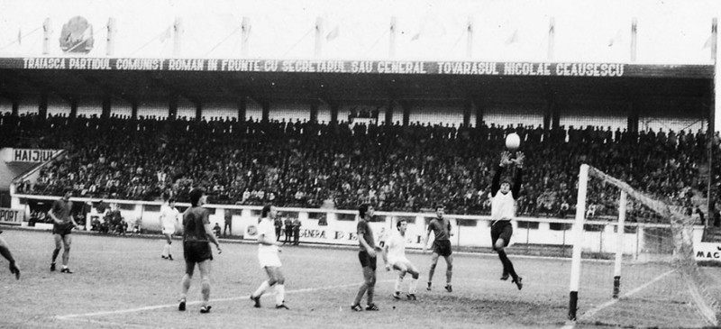

B. Forming Teams
Ganescu Robert Florinel
PowerPoint + Code

Slide 2

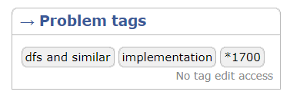


Limits and Tags.

Slide 3
Statement.
One day n students come to the stadium. They want to play football, and for that they need to split into teams, the teams must have an equal number of people.
We know that this group of people has archenemies. Each student has at most two archenemies. Besides, if student A is an archenemy to student B, then student B is an archenemy to student A.
The students want to split so as no two archenemies were in one team. If splitting in the required manner is impossible, some students will have to sit on the bench.

Slide 4
What I have to do:
Determine the minimum number of students you will have to send to the bench in order to form the two teams in the described manner and begin the game at last.

Slide 5
Input/Output:
The first line contains
two integers n and m (2 ≤ n ≤ 100, 1 ≤ m ≤ 100).
the number of students
the number of pairs of archenemies
correspondingly.
Next m lines describe enmity between students. Each enmity is described as two numbers a i and b i (1 ≤ a i, b i ≤ n, a i ≠ b i) - the indexes of the students who are enemies to each other. Each enmity occurs in the list exactly once. It is guaranteed that each student has no more than two archenemies.
You can consider the students indexed in some manner with distinct integers from 1 to n.
Print a single integer — the minimum number of students you will have to send to the bench in order to start the game.

Slide 6
Example 1:
Input:
5 4 1 2 2 4 5 3 1 4
Output:
1
1
2
3
4
5

Slide 7
Example 1:
1
2
3
5
4

Slide 8
Example 2:
Input:
6 2 1 4 3 4
Output:
0
1
2
3
4
5
6

Slide 9
Example 2:
1
2
3
4
5
6

Slide 10
Example 3:
Input:
6 6 1 2 2 3 3 1 4 5 5 6 6 4
Output:
2
1
2
3
4
5
6

Slide 11
Example 3:
1
2
Input:
6 6 1 2 2 3 3 1 4 5 5 6 6 4
3
4
5
6

Slide 12
I have 3 cases:
1. Pacifists
1
2
3
4
If the number of pacifists is odd, one player is added to team1.
5
6
(Ex. 2)

Slide 13
I have 3 cases:
2. Elementary chain
1
2
3
4
If the chain is odd, one player is added to smaller team.
5
6
(Ex. 2)

Slide 14
I have 3 cases:
1
2
3. Elementary cycle
3
4
5
If the cycle is odd, add one to the final answer.
(Ex. 1)

Slide 15
Solution:
The solution is based on checking each element in the graph.
1. Find out the number of pacifists.
2. Find out if the chains is odd.
3. Find out if the cycles is odd.
4. Check if teams are equal by number of players.

Slide 16
Final.

